Slide 1
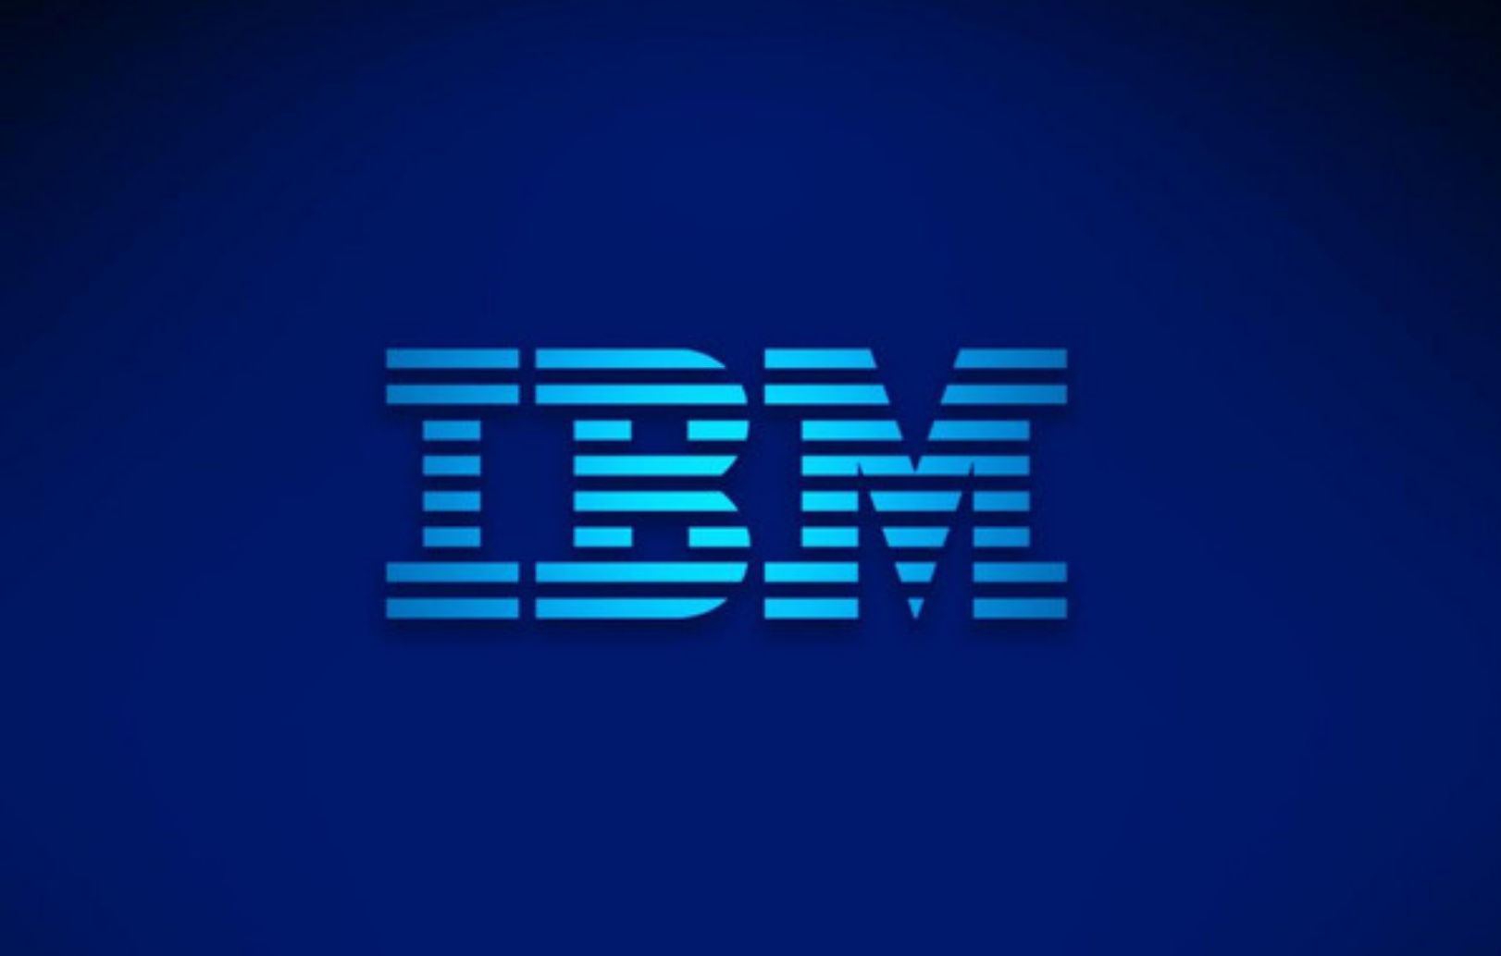

IBM Developer - Semantic Graph Workshop
January 2020
Ver 1.0.0
Grant Steinfeld – Developer Advocate IBM, Blockchain, JVM and Cognitive Applications
https://github.com/Grant-Steinfeld

Slide 2
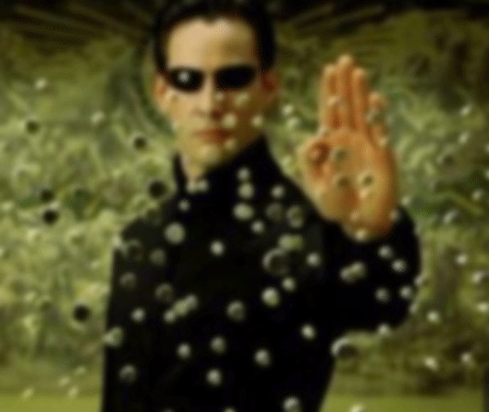
Data
Why I love it?
Notes:
Botanist
Fast
Inmotion
Lots of it

Slide 3
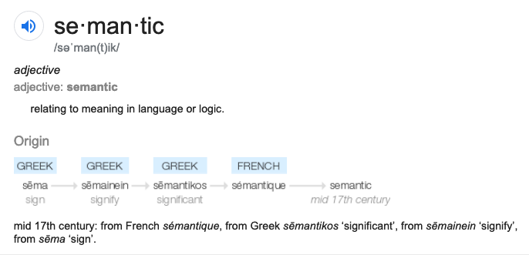
Semantic
MEANING | KNOWLEDGE

Slide 4
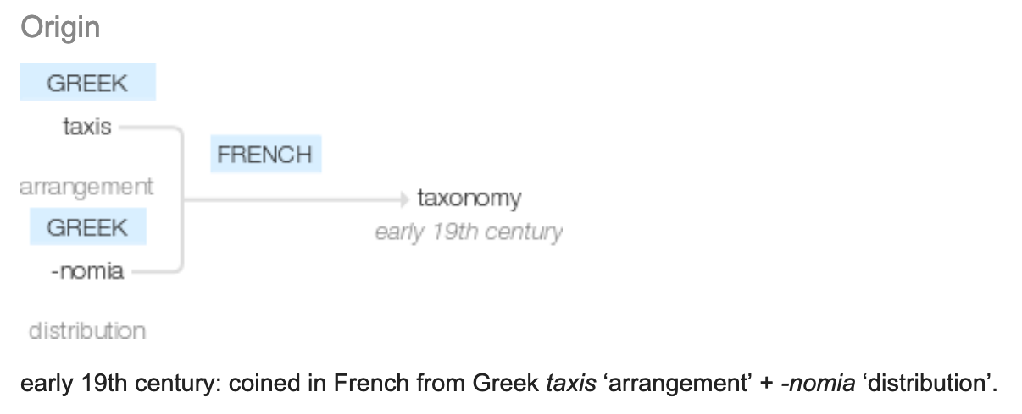
Taxonomy
Notes:
ONTOLOGY

Slide 5
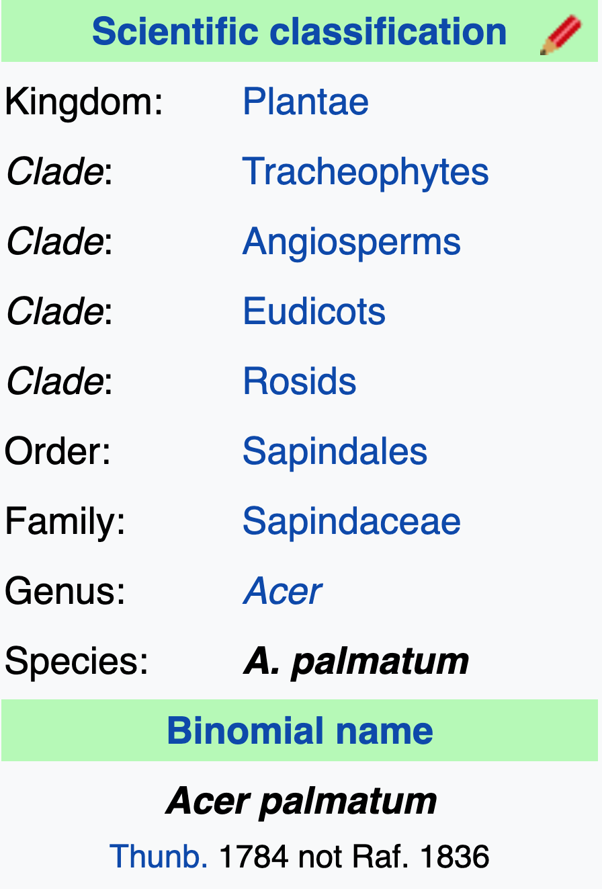

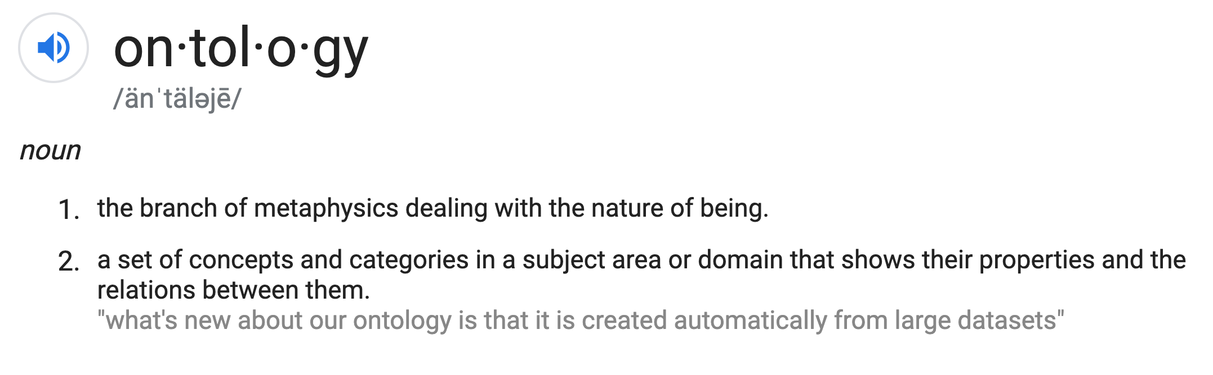
Ontology

Slide 6

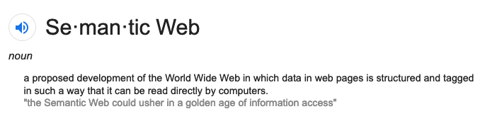
Golden age of Information Access

Slide 7
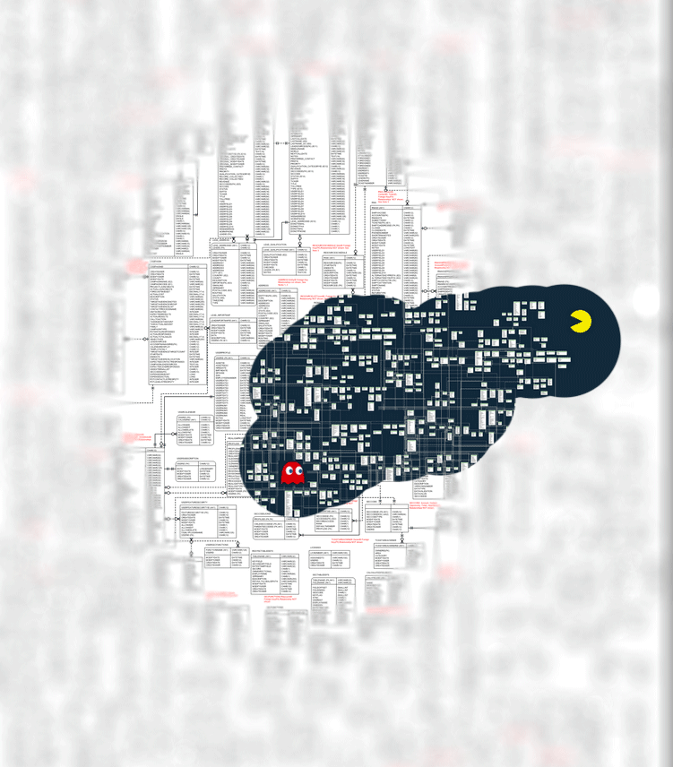
Inference New Ideas + Hypotheses Patterns
Notes:
LOOKING FOR
FINDING PATTERNS

Slide 8
Why?
Data
Volume huge
ETL
Retrieval / Query

Slide 9
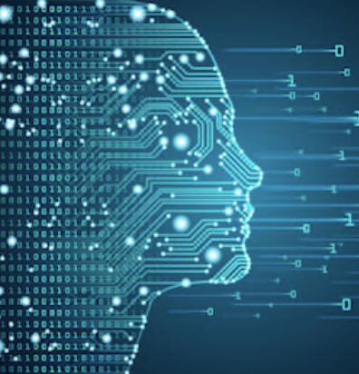
Web – worlds biggest `sensor`
Web pages – Human readable – unstructured
What is machine readable? – structured
Big Fast Moving Data – overwhelming TL;DR;
Notes:
How to Derive Structure from Unstructured Web
Google search – good for humans

Slide 10
RDF – sums it up
Resource Description Framework
RDF is a standard model for data interchange on the Web
.
RDF has features that facilitate data merging even if the underlying schemas differ.
Specifically supports the evolution of schemas over time, without requiring all
the data consumers to be changed.

Slide 11
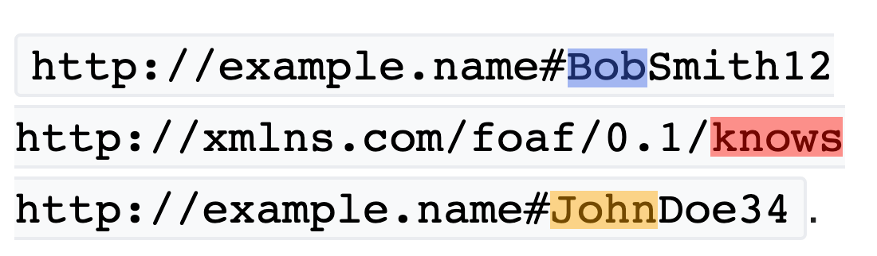
RDF Triples
SUBJECT
PREDICATE
OBJECT
Notes:
RDF extends the linking structure of the Web to use URIs to name the relationship between things as well as the two ends of the link

Slide 12
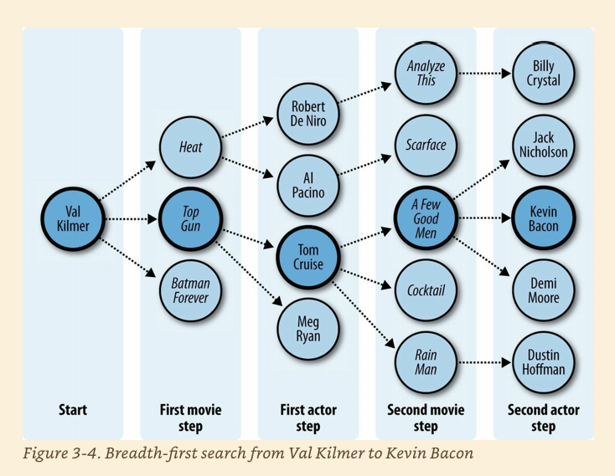
FOAF Six degrees of seperation
Notes:
﻿Six Degrees of Kevin Bacon A good example of the breadth-first search algorithm is the trivia game “Six Degrees of Kevin Bacon,” where one player names a film actor, and the other player tries to connect that actor to the actor Kevin Bacon through the shortest path of movies and co-stars. For instance, one answer for the actor Val Kilmer would be that Val Kilmer starred in Top Gun with Tom Cruise, and Tom Cruise starred in A Few Good Men with Kevin Bacon, giving a path of length 2 because two movies had to be traversed.
Evans, Colin. Programming the Semantic Web: Build Flexible Applications with Graph Data (p. 51). O'Reilly Media. Kindle Edition.

Slide 13
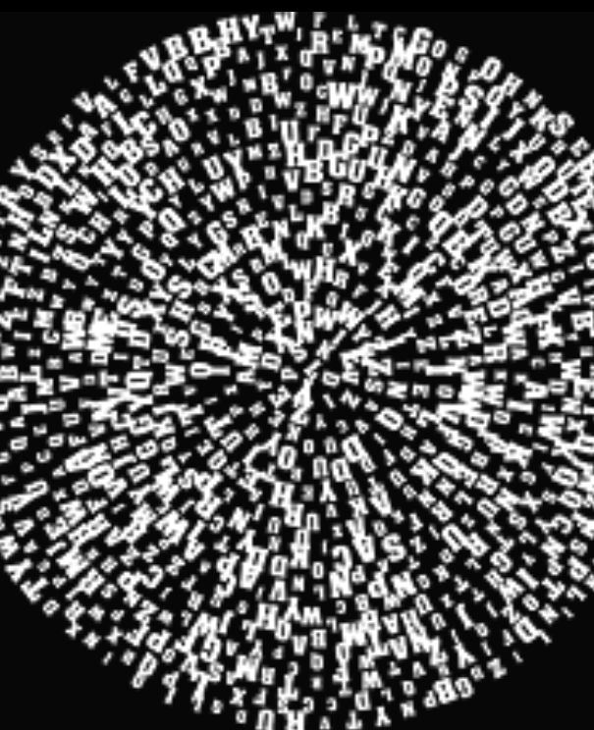
Triple `Soups`
Bowl -> Triple Store – Semantic Graph DB
`Alphabet soup` -> SPO OPS POS SOP POS
Merge ?
Notes:
Merge Using this simple model, it allows structured and semi-structured data to be mixed, exposed, and shared across different applications.

Slide 14
Flavors
N-Triples
RDF
aRDF

Slide 15
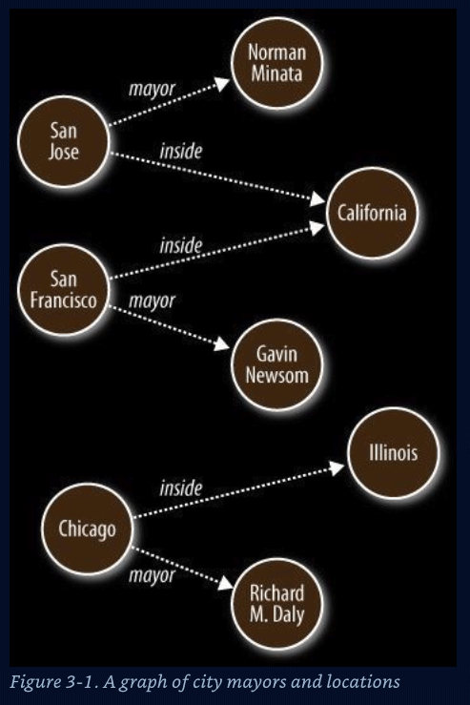
Graph
Nodes – Data Entities ( nouns )
S O
Edges – Relationships ( verbs )
P
Graph algorithms
Reasoning ( Decisions )
Inferences
Shortest path
Cliques / Neighborliness
Interconnected ness
Patterns
Notes:
Represent data that is hard to store in columnar and row format

Slide 16
Use cases for semantic / graph
Social Networks - FOAF
Bio-Informatics
Music
Portfolio Analysis
Fraud detection – AML
Notes:
AML anti money laudering – human trafficking, illegal arms dealers,

Slide 17
Where to find existing semantic data
DBPedia
Wikimedia / Commons
Schema.org – labels (P)

Slide 18
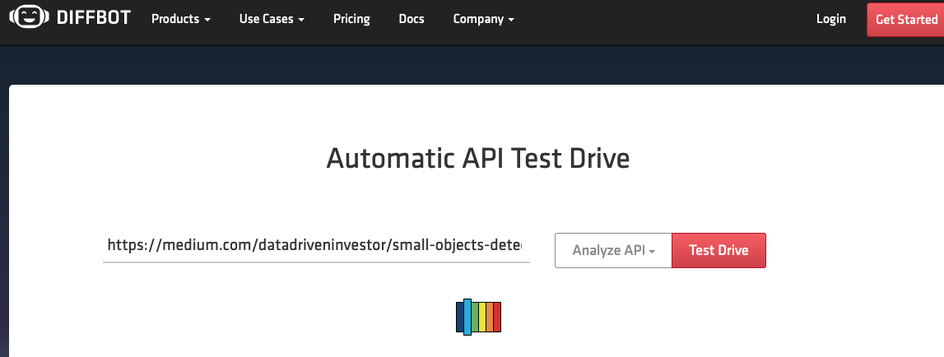
Extraction – demo 1

Slide 19
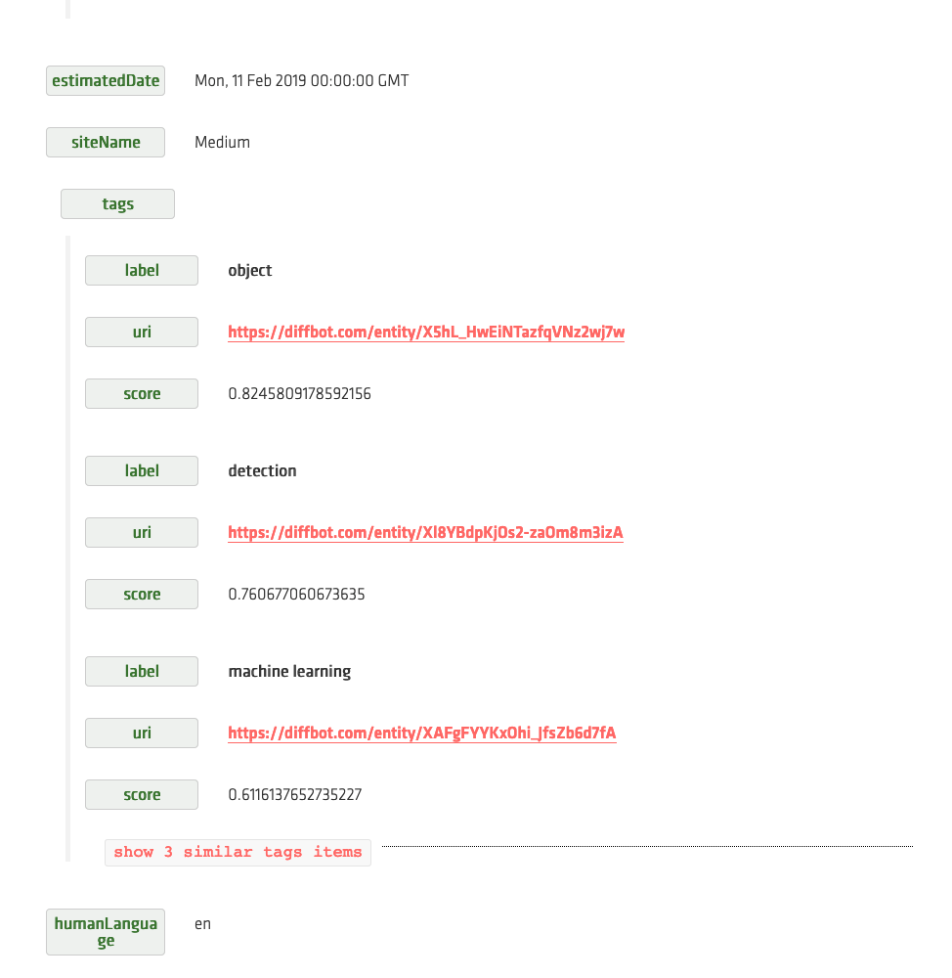
Extraction

Slide 20
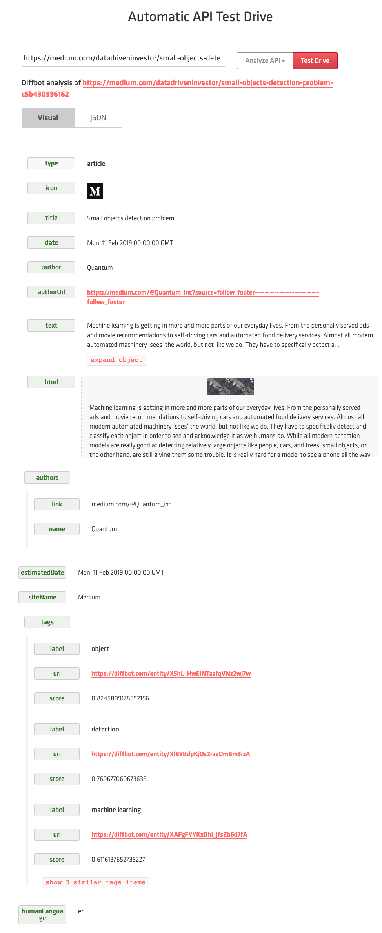

Slide 21
Popular Semantic/Graph databases
AllegroGraph RDF store
Janus Graph – IBM Cloud https://janusgraph.org/
Neo4j

Slide 22
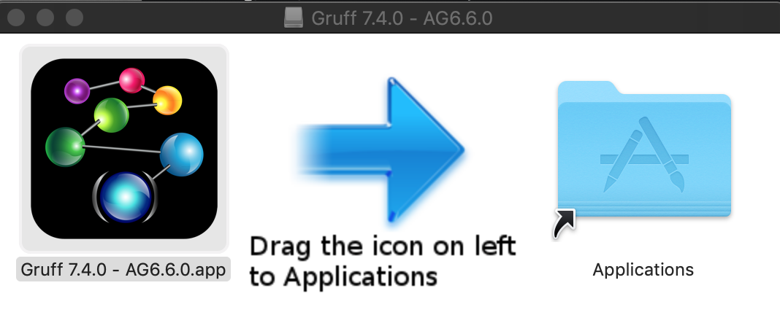
Demo Gruff
Notes:
Show pizza in Web View - Add Triples … then display sample nodes

Slide 23
Docker version of Agraph https://franz.com/agraph/docker/

Slide 24

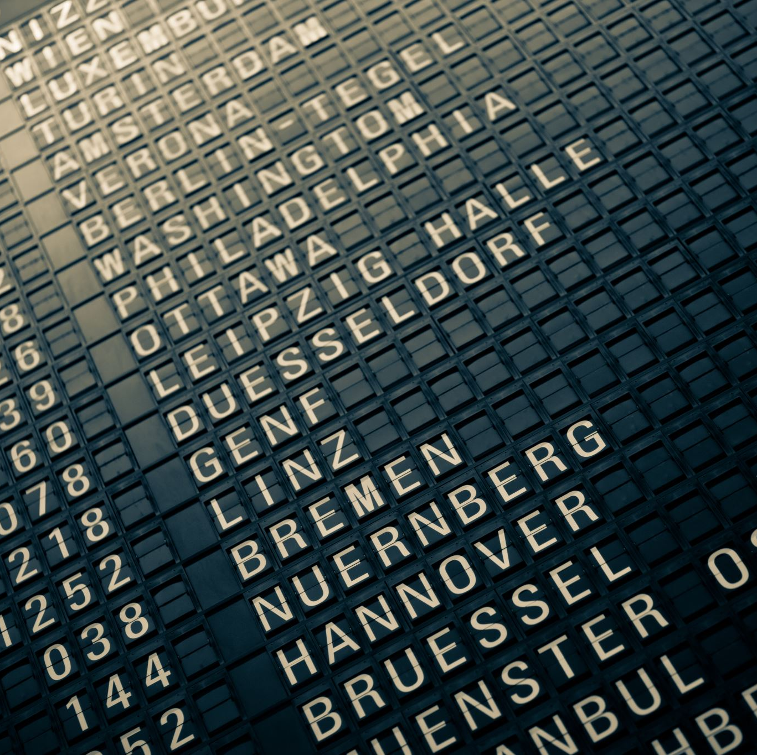


Thank you!!
https://github.com/Grant-Steinfeld/
Signup for a free IBM Cloud Account today
https://ibm.biz/BdqdPZ
https://www.linkedin.com/in/grant-steinfeld/
@gsteinfeld

Slide 25
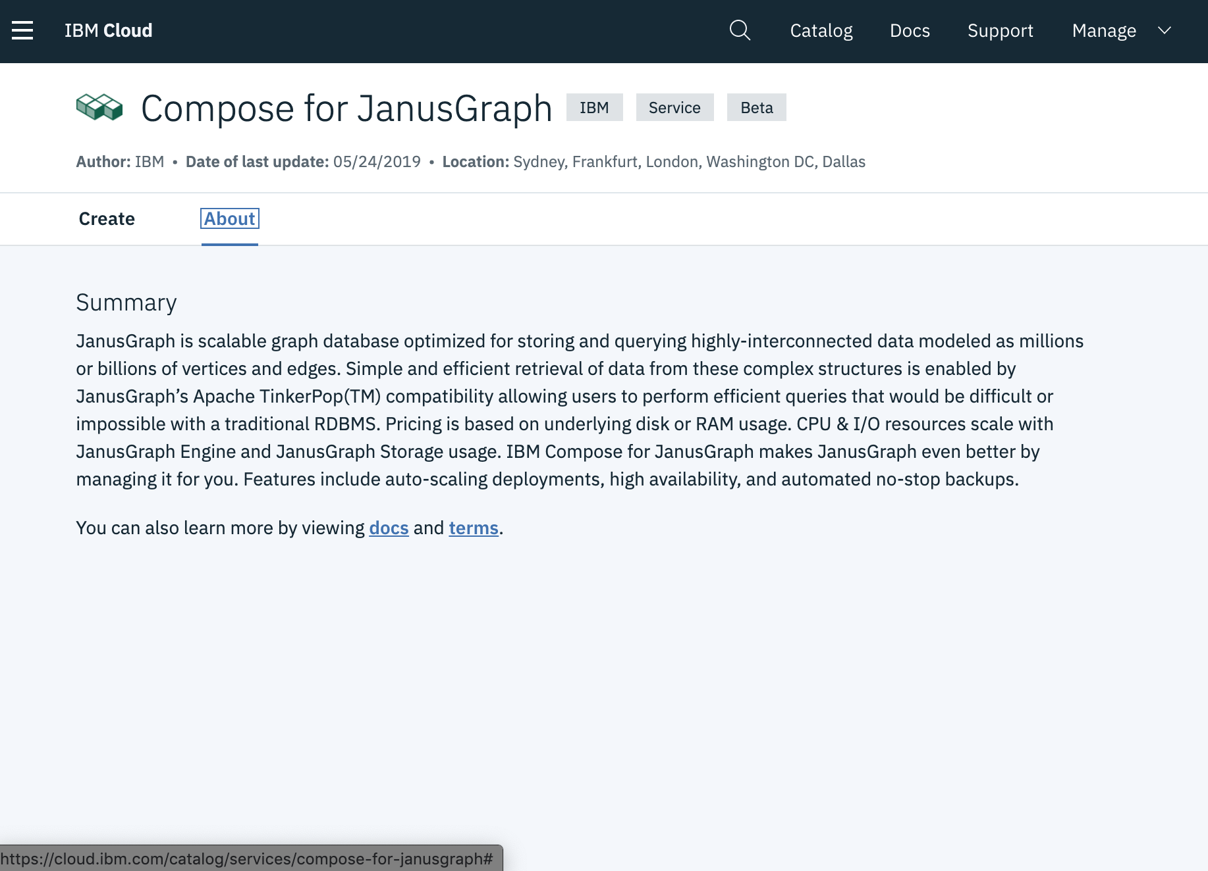
Janus Graph
Distributed
open source
massively scalable
graph database
IBM Catalog

Slide 26
Resources
﻿N-TRIPLES spec - http://www.w3.org/TR/rdf-testcases/#ntriples.
Evans, Colin. Programming the Semantic Web: Build Flexible Applications with Graph Data (p. 71). O'Reilly Media. Kindle Edition.

